Slide 1
Intermediate Python
Cori Hatley

Slide 2
Lab 1
Hello, matplotlib

Slide 3
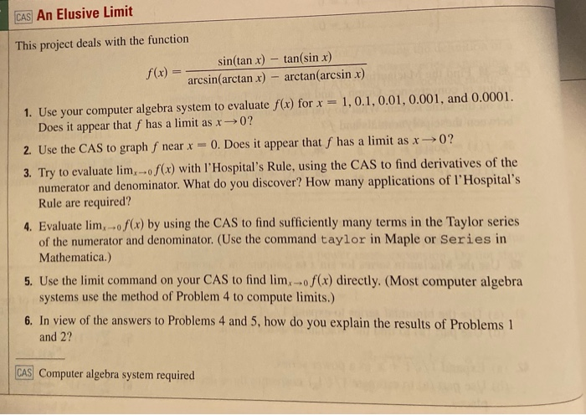
Objectives
Design programs that visualize:
At least two full periods of a sine wave
A cubic polynomial
Find the limit →

Slide 4
The Sine Wave
Equation of the form:
y = Asin[B(x-C)]+D
Define the variables where:
A is the amplitude
B is (2π/period)
C is phase shift
D is vertical shift
x is the independent variable
Label the axes
Use numpy.arange to get x values?
Get y values with equation
Display on a grid

Slide 5
The Cubic Polynomial
Equation of the form:
y = a(x^3)+b(x^2)+cx+d
Define the variables where:
a, b, c, and d are constants
x is the independent variable
Label the axes
Y-scale: 100
X-scale: 0.5
Use numpy.arange to get x values?
Use equation to get y values

Slide 6
An Elusive Limit
Equation of the form:
Y = [(sin(tanx) - tan(sinx))]/ [(arcsin(arctanx) - arctan(arcsinx))]
Define the variables where:
x is the independent variable
Label the axes
Y-scale: 1
X-scale: π/4
Use numpy.arange to get x values?
Use equation to get y values

